Slide 1
E-Commerce Sales Dashboard Project – Power BI
By
Kranthi Kumar Reddy Yaramala

Slide 2
CONTENTS
OBJECTIVE
DATA SOURCING AND DATA CLEANING
OVERVIEW
PROFIT BY MONTH
SALES BY STATE
QUANTITY BY CATEGORY
QUANTITY BY PAYMENT MODE DISTRIBUTION
SALES BY CUSTOMER
PROFIT BY SUB-CATEGORY
BUSINESS INSIGHTS AND KEY FINDINGS
RECOMMENDATIONS
CONCLUSION

Slide 3
OBJECTIVE
The main objective of this project is to analyze sales performance for an E-Commerce company over a specific time period.
It will make us understand about the overall performance of the sales and profits by month, state and category and sub-category and customer wise as well in E-Commerce company.
With this project we can easily understand how the performance of the sales which will effect the overall growth and revenue of the E-Commerce Company.

Slide 4
Data sourcing and data cleaning
Data Sourcing:
For this project I have used the datasets of details and orders csv files which are provided by the company
Data Cleaning:
After Downloading the datasets I have exported the both the datasets to Microsoft Excel in order to check for inconsistencies and clean the datasets to make it usable for visualization and analysis in the datasets looking fine and I have changed the date format and finally the dataset is ready for usage in this project.

Slide 5
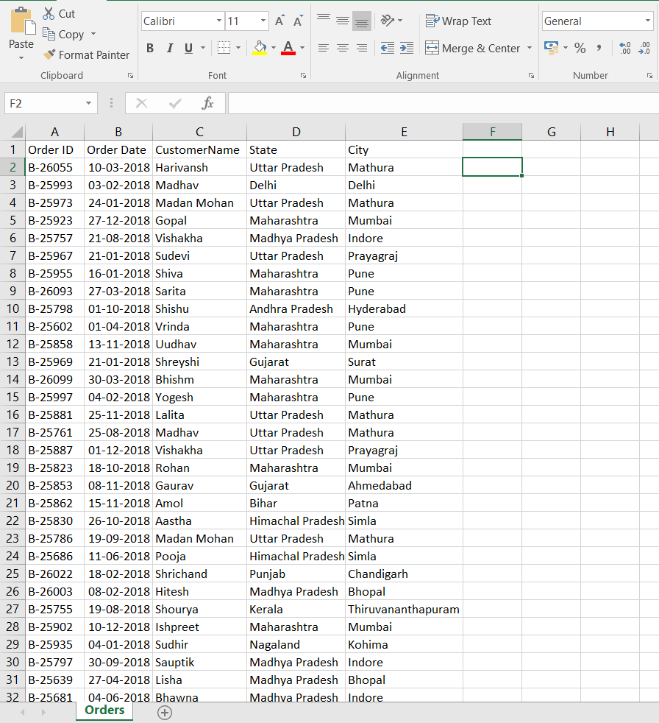
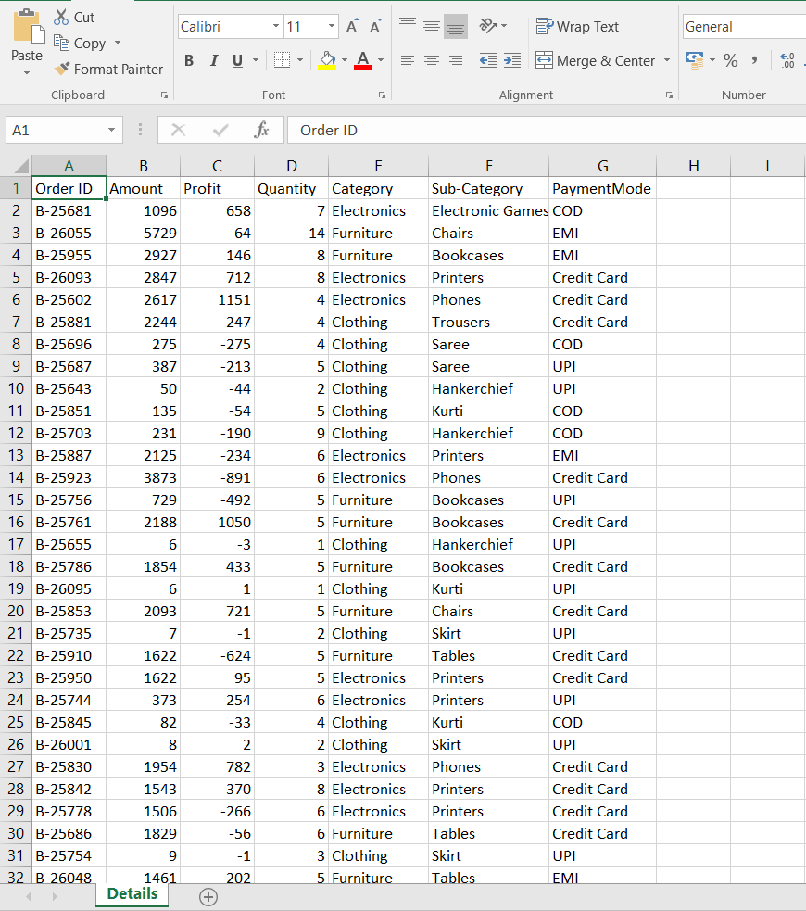
Screenshots for data cleaning
Orders
Details

Slide 6
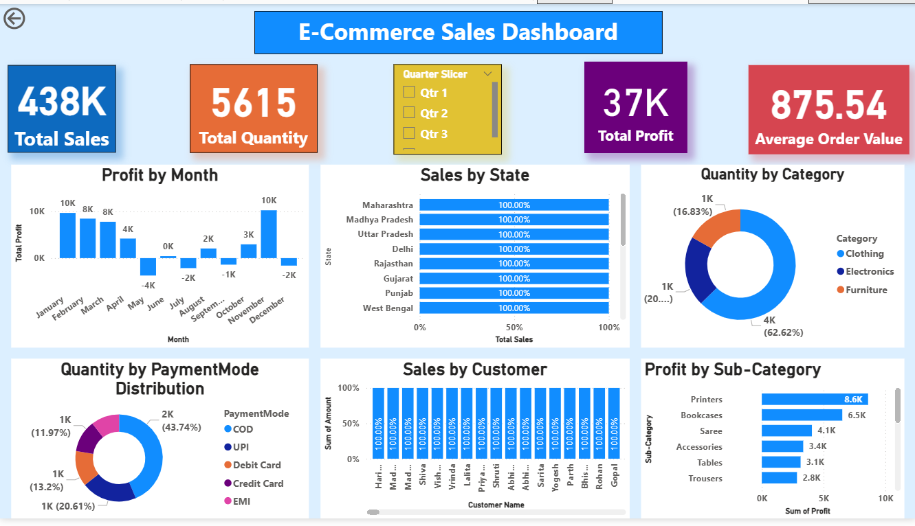
Overview
The dashboard presents a comprehensive view of the sales performance across multiple dimensions like categories, month, customer and state

Slide 7
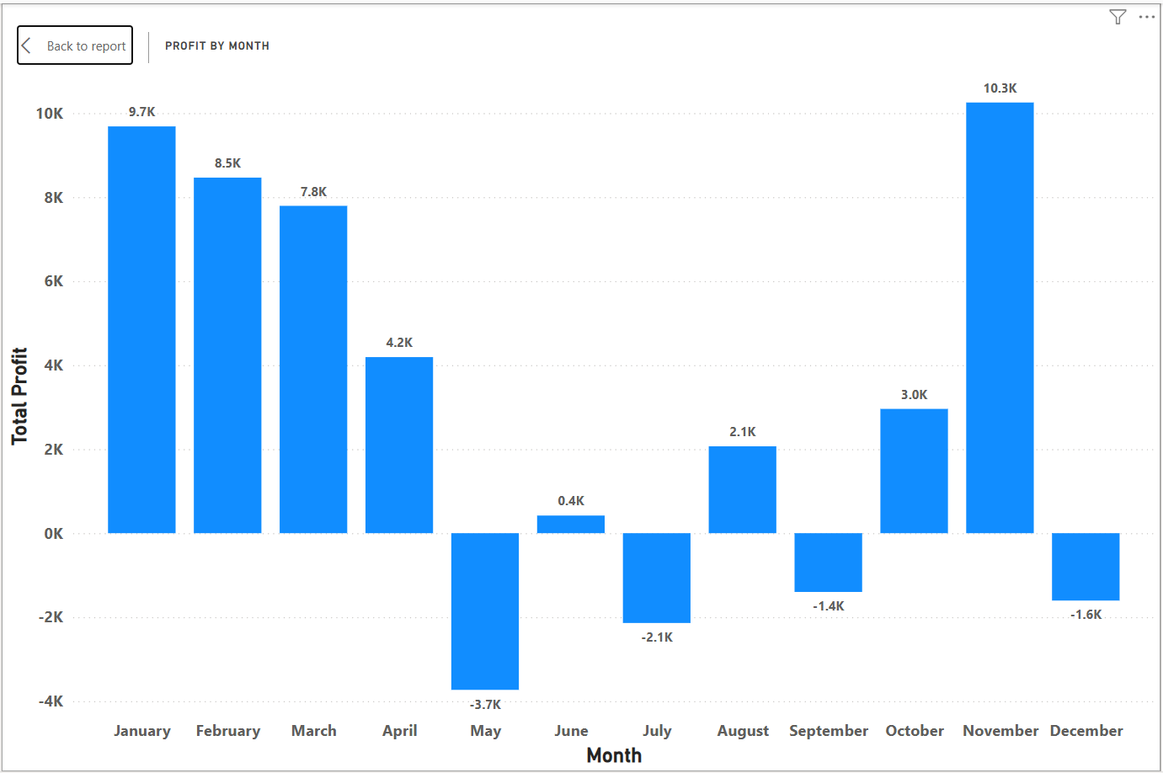
PROFIT BY MONTH
INSIGHTS:
January (9.7K), February (8.5K), and November (10.3K) are the strongest months, indicating high-demand periods.
May (-3.7K), July (-2.1K), September (-1.4K), and December (-1.6K) experienced substantial losses.

Slide 8
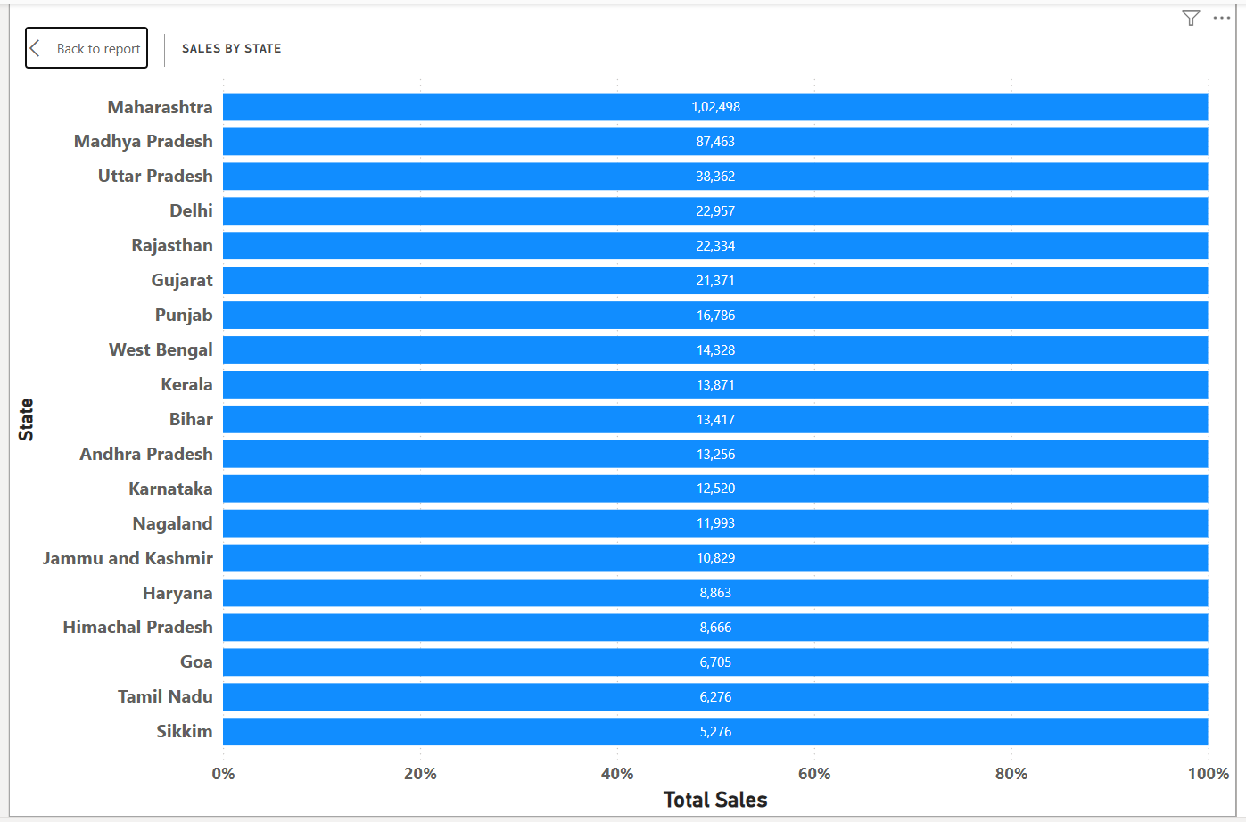
Sales by state
INSIGHTS:
Maharashtra is the dominant sales region with $102,498 in sales, vastly outperforming the next closest state, Madhya Pradesh (87,463).

Slide 9
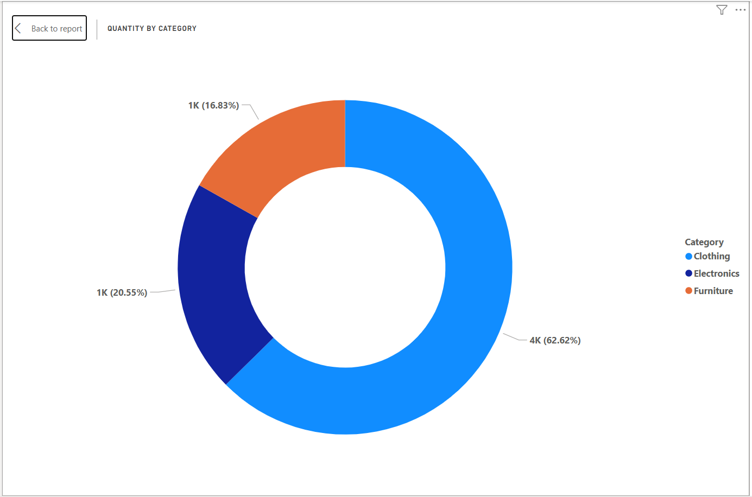
Quantity by category
INSIGHTS:
Clothing dominates the sales volume, accounting for the largest share at 62.62% (4K units).
Electronics (20.55%) and Furniture (16.83%) make up the remainder.

Slide 10
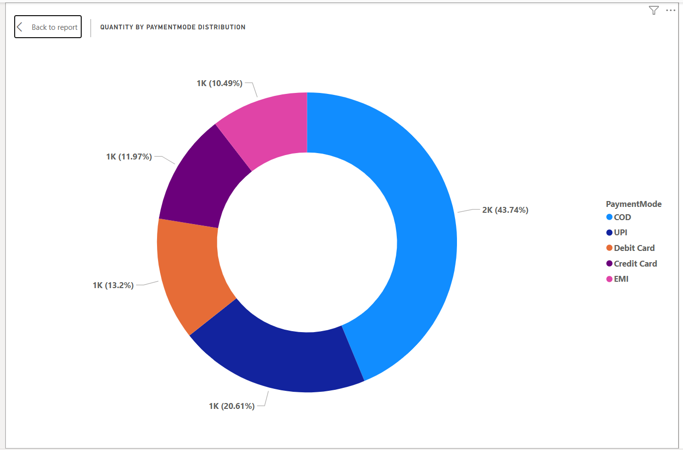
QUANTITY BY PAYMENT MODE DISTRIBUTION
INSIGHTS:
COD (Cash on Delivery) is the most popular payment method, representing 43.74% (2K units) of the quantity sold.
UPI (20.61%) is the second most used, followed by Debit Card (13.2%).

Slide 11
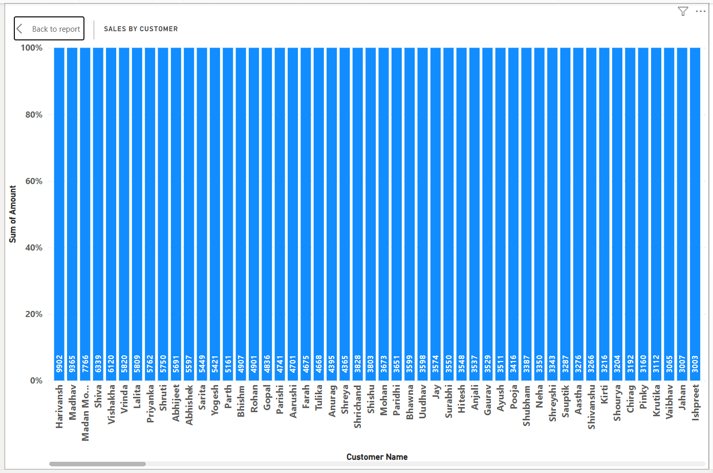
Sales by CUSTOMER
INSIGHTS:
Harivansh (9,903) and Madhav (9,365) are the top-spending customers.

Slide 12
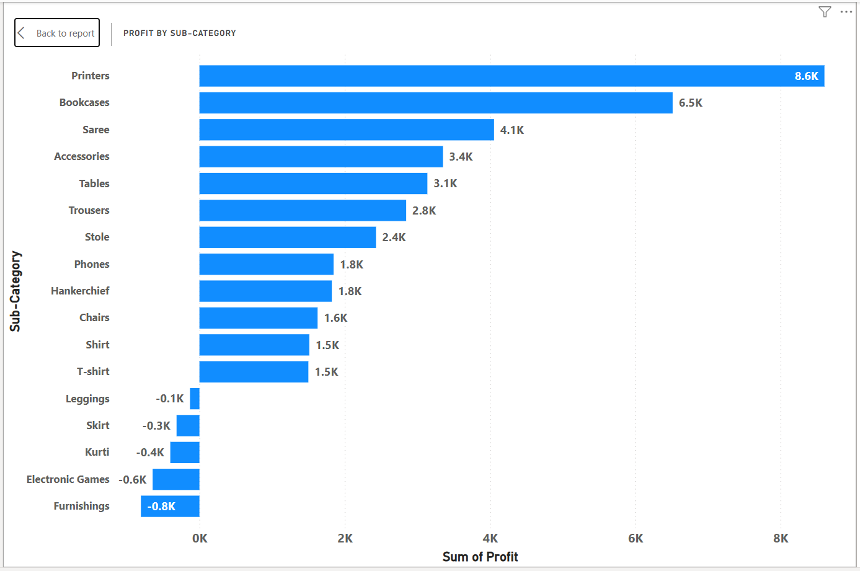
PROFIT BY SUB-CATEGORY
INSIGHTS:
Printers ($8.6K) and Bookcases ($6.5K) are the highest-profit sub-categories.
Furnishings (-$0.8K), Electronic Games (-$0.6K), Kurti (-$0.4K), Skirt (-$0.3K), and Leggings (-$0.1K) are unprofitable.

Slide 13
Business insights and key FINDINGS
Business Insights :
Profit by Month :
January (9.7K), February (8.5K), and November (10.3K) were the most profitable months.
The business incurred substantial losses in May (-3.7K), July (-2.1K), September (-1.4K), and December (-1.6K). This severe inconsistency in the middle and end of the year requires urgent investigation into operational costs, discounts, or inventory issues during these periods.
Sales by State :
Maharashtra is the dominant sales region with $102,498 in sales, vastly outperforming the next closest state, Madhya Pradesh (87,463).
Quantity by Category :
Clothing dominates the quantity sold, accounting for 62.62% (4K units). This confirms Clothing is the highest-volume category, but its high volume doesn't translate to the highest sub-category profit (Printers/Bookcases are better).

Slide 14
Quantity by Payment Mode Distribution :
COD (Cash on Delivery) is the preferred method for the majority of sales quantity at 43.74% (2K units).
Sales by Customer :
Harivansh (9,903) and Madhav (9,365) are the top-spending customers.
Profit by Sub-Category :
A few sub-categories generate the majority of the profit: Printers (8.6K) and Bookcases (6.5K) are the undisputed leaders.
Five sub-categories are actively eroding profits Furnishings (−0.8K), Electronic Games (−0.6K), Kurti (−0.4K), Skirt (−0.3K), Leggings (−0.1K)

Slide 15
KEY FINDINGS
The overall profitability is low relative to the high total sales, indicating a thin margin or significant cost/loss issues that need to be addressed to boost the total profit of $37K.
Profitability is highly volatile. The substantial losses in May and December—often prime shopping months—require immediate investigation into sales strategies, cost spikes, or return rates.
Sales efforts should prioritize key regions like Maharashtra while developing strategies to boost sales in lower-performing states like Sikkim (5,276) and Tamil Nadu (6,276).
The business's operational logistics are heavily geared toward, and dependent on, the high volume of the Clothing segment.
Heavy reliance on COD introduces higher logistical costs, greater risk of delivery failure, and delayed cash flow. UPI (20.61%) is the second most popular pre-paid method.
The business has a critical issue with loss-making products. The −2.2K in combined losses from these five sub-categories is directly reducing the overall 37K total profit.

Slide 16
Recommendations
Immediately review the COGS (Cost of Goods Sold) and pricing strategy for Furnishings, Electronic Games, Kurti, Skirt, and Leggings.
Increase stock levels, marketing focus, and cross-selling efforts for Printers and Bookcases (e.g., offer a "Printer Cartridge Subscription" or "Bookcase Organization Bundle").
Launch a dedicated investigation into the operational and marketing activities during May and December to pinpoint the cause of negative profit. Was there excess promotional discounting or a spike in returns/logistics costs?
Implement a consistent minimum gross margin requirement and enforce stricter control over discretionary discounting, especially during known loss months.
Actively promote UPI and Card Payments to reduce the COD share. Offer a small incentive (e.g., 2% discount or free express shipping) for pre-paid orders to improve cash flow and reduce the risk of returns/refusals.
if the high-volume Clothing (62.62%) contributes to the low AOV. Develop bundles or "Complete the Look" promotions to increase the AOV within the dominant category.
Maintain dominance in Maharashtra and launch targeted, cost-effective campaigns in high-potential, lower-volume states like Kerala, Karnataka, and Nagaland to diversify sales risk.
Create an exclusive "Gold Tier" program for top customers like Harivansh and Madhav, offering early access to sales, dedicated support, or personalized discounts to ensure retention and maximize their lifetime value.

Slide 17
CONCLUSION
The E-Commerce sales project demonstrates a business with strong gross revenue and high volume, yet critical issues around profitability and stability must be addressed to maximize potential and the conclusion is that the business is highly effective at driving volume, particularly in the Clothing category (62.62% of quantity), but is being significantly hindered by major monthly profit volatility and the existence of multiple loss-making product sub-categories and The immediate strategic priority must shift from simply maximizing sales to maximizing profitable sales. The business must take decisive action is to Eliminate or repriced loss-making, Investigate and stabilize the profit curve, Incentivize pre-paid methods

